Slide 1
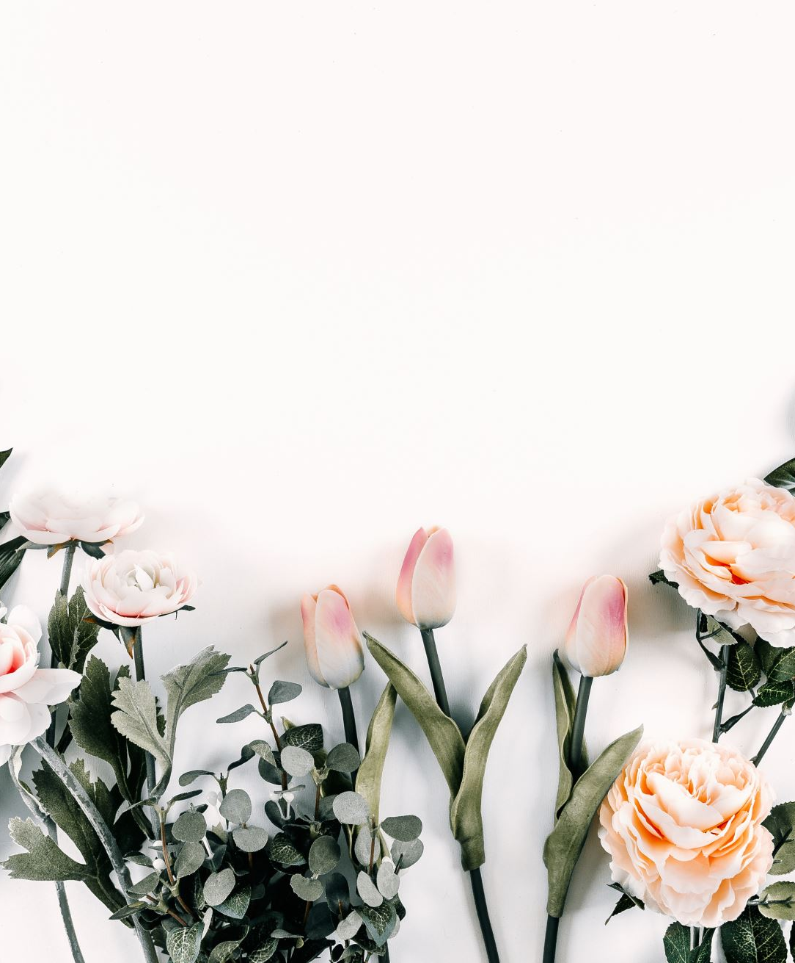
SMART PLANTATION
DONE BY:
N180607-A.RAMYA
N180600-K.PREM
N180595-K.SRIVANI KRUPA

Slide 2
About the Project
Solution for Over Flow of Water
Less time consuming
Drip Irrigation System
Smart Plantation promotes Greenary to our environment.
Helps to grow flowers and vegetables in our home.

Slide 3
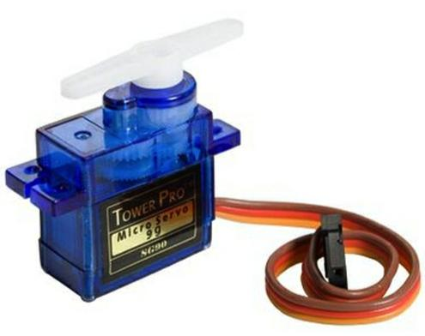
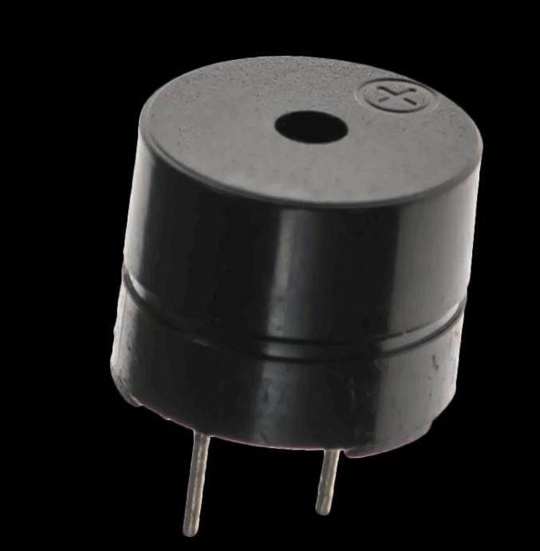
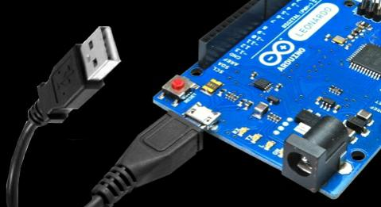
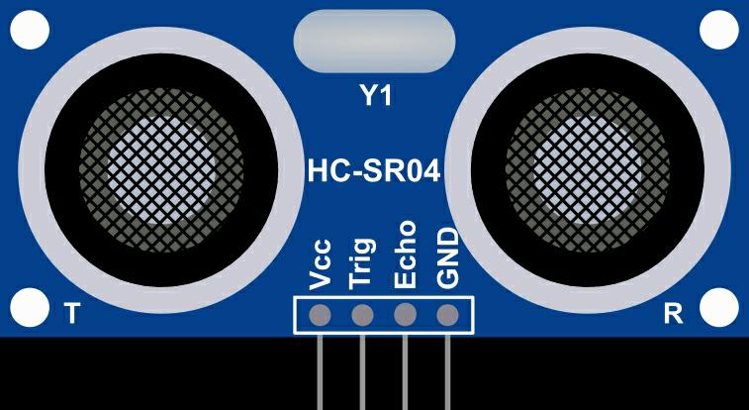
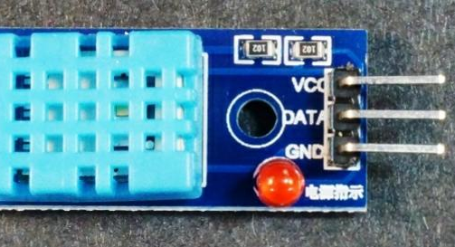
Components
ARDUINO
DHT11 SENSOR
ULTRASONIC SENSOR
BUZZER
SERVO MOTOR

Slide 4
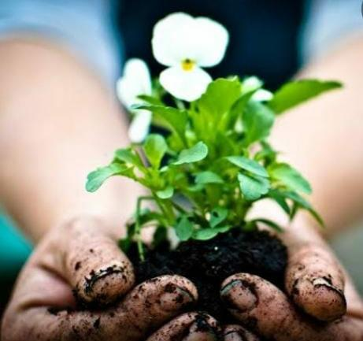
Application
Busy lifestyle of people.
Scope of Smart Plantation in human life.
Smart Plantation is the better way to grow plants

Slide 5
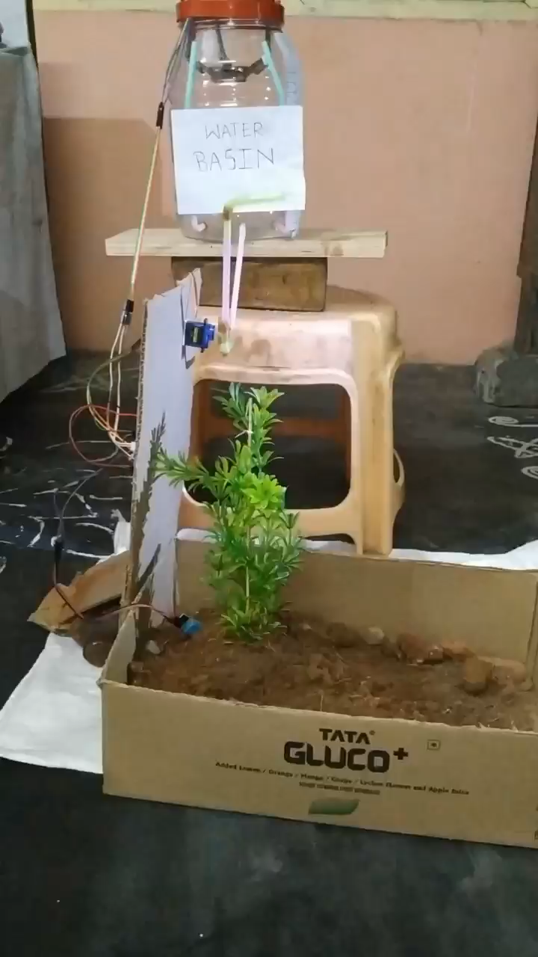
WORKING MODEL

Slide 6
THANK YOU

